Slide 1
Shawn Healy
Resident Scholar and Director of Professional Development
McCormick Foundation Civics Program
Mary Ellen Daneels
National Board Certified Social Studies Teacher
West Chicago Community H.S.
McCormick Foundation Civics Program Simulations, Role Play, and Dramatization
Notes:
1

Slide 2
Simulations, role plays, and dramatization distinguished
Simulations: focus on set design
-creation of an alternative environment
-students play a functional role
-students possess adequate information to make decisions and interact with one another
-students retain their own personality
Role plays: focus on actors’ roles
-students act as someone different than themselves
-less emphasis on environment or situation
-usually brief, and audience is classmates
Dramatizations: focus on scripted dialogue
-students act in a given role, during a scene, and with a script
Notes:
Where do your young patrons/ students get their news?

Slide 3
Simulation terminology
Notes:
3
Where do your young patrons/ students get their news?

Slide 4
What do students learn from CHS Legislative Semester?
Basic tenets of the left and right of the political spectrum
Their values in relation to the political spectrum
Federalism
Political forces
Civil discourse: respect of dissenting opinion, agree to disagree
Respect of others
Power of persuasion
Danger of apathy
Importance of leadership
Power/ danger/ problems of factions

Slide 5
What do students learn from CHS Legislative Semester?
How government works
Power of information
Voting as a responsibility
Current events/expanded exposures
Legislative process
“Like school”
Active listening: ask clarifying questions, restate main point of the speaker, request the floor to add to the speaker’s premise
Student empowerment: “we are in control” of an authentic experience
The role of the teacher as facilitator and the different role of the student teacher as “engineer” and student as “driver”
Citizens are responsible for creating a “safe environment" for democracy to thrive

Slide 6
What teachers have to keep in mind
Flexibility
Loss of control
Organization and preparation
“Teachable moments”
Depth vs. Breadth
Assessment
Objective
Anecdotal
Student Self-Assessment
Reflection by Student
Need for collaboration
With Peers
With Students

Slide 7
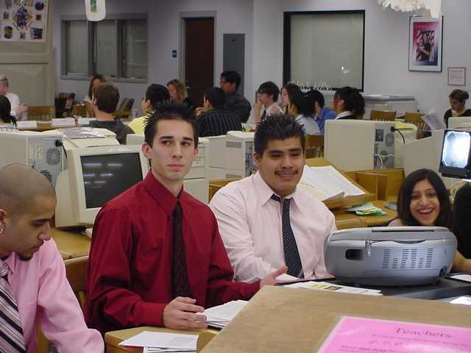
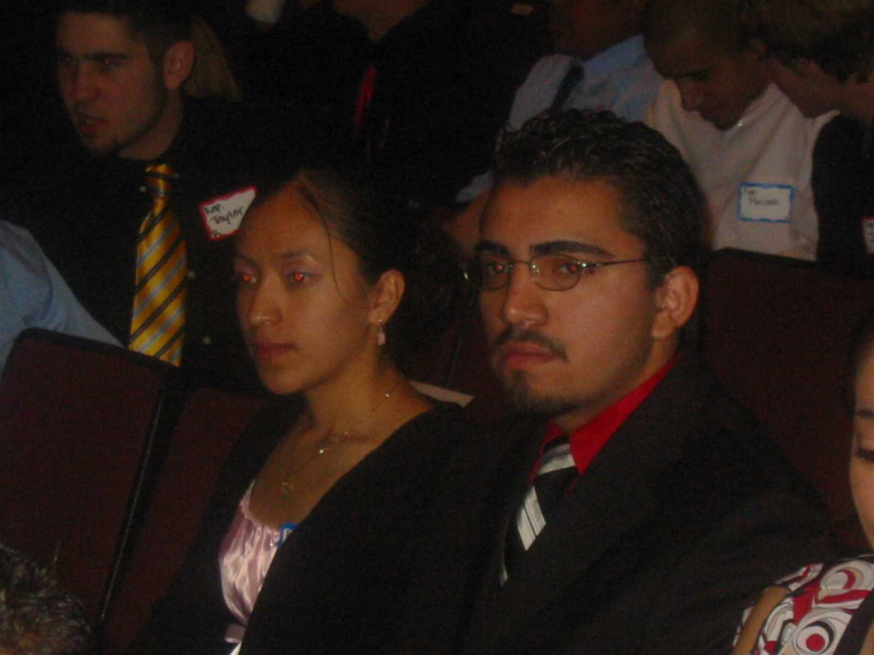
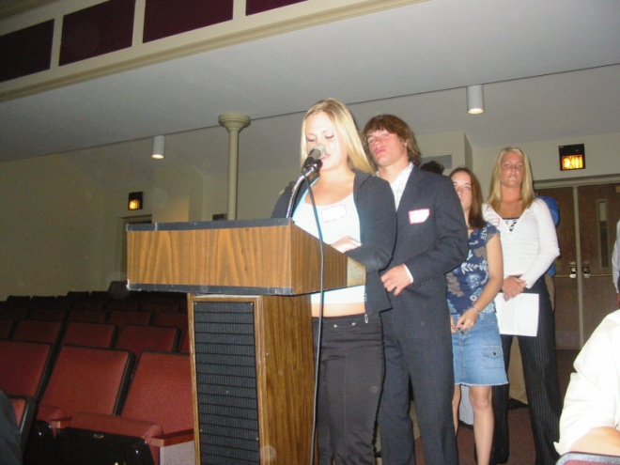
In their own words….

Slide 8
Civic Mission Coalition “Democracy Schools”
Formal Instruction in U.S. government, history, law and democracy using interactive methods and opportunities to apply learning to “real life” situations
Discussion of current events that students view as important to their lives; discussion puts formal civic instruction in context of current political issues
Service Learning: research, advocacy, direct action, indirect action
Student Voice in school governance

Slide 9
Carole Cosimano
Illinois Humanities Council
McCormick Foundation Civics Program Illinois Capitol Forum
Notes:
9

